Slide 1



BetterCrypto⋅org
Applied Crypto Hardening
David Durvaux
Brussels, 9th June 2014

Slide 2
Attendees Reminder:
What occurs in a M³AAWG meeting cannot be shared outside the membership
Blogging, tweeting, posting is NOT allowed EXCEPT for referencing or citing the specific content on official M³AAWG public sites, which can be reposted or used in articles. The official sites are: www.m3aawg.org/DM3Z, www.Twitter.com/maawg, www.Facebook.com/maawg, https://www.facebook.com/groups/maawg/
Respect M³AAWG anonymity: No publishing people or company names, except as cited on the official M³AAWG channels listed above
No use of Wireshark or similar products on the M³AAWG network
No photography - No video - No audio recording
Any exception requires written permission from the Executive Director and may require permission from the session members
All meeting attendees must wear and have their M³AAWG badge visible at all times during the meeting
Please silence all electronic devices; be courteous to those listening to the presentations
Treat all attendees respectfully in and out of sessions. No less will be tolerated.
Please review our meeting Conduct Policy at http://www.m3aawg.org/page/m3aawg-conduct-policy
For questions, please contact Jerry Upton at: jerry.upton@m3aawg.org

Slide 3






Reminders for Our Worldwide Friends
All meeting content is confidential: No photos, no video, no recording. See staff with questions.
L’ensemble du contenu de la réunion est confidentiel : les photos, vidéos et enregistrements sont interdits. Pour toute question, demandez conseil au personnel.
Todo el contenido de la reunión es confidencial: No está permitido sacar fotografías ni grabar vídeo o audio. Consulte con el personal si tiene alguna pregunta.
Der gesamte Inhalt des Meetings ist vertraulich: Keine Fotos, kein Video, keine Tonaufzeichnung. Bei Fragen wenden Sie sich an die Mitarbeiter.
会議の内容はすべて機密扱いです。 写真やビデオの撮影、録音は禁止されています。質問がある方は、スタッフまでご連絡ください。
所有会议内容均为保密信息：禁止拍照、录像、录音。如有疑问，请咨询职员。
회의에서 다루는 모든 내용은 기밀입니다. 사진 및 동영상 촬영과 녹음은 금지됩니다. 질문이 있으시면 직원에게 문의해 주십시오.

Slide 4
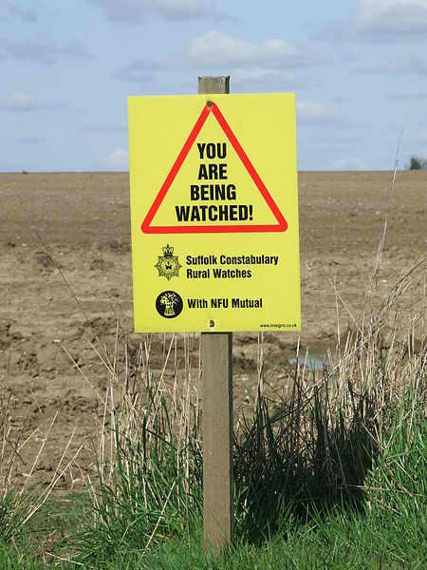
This talk is recorded

Slide 5
Why better crypto?

Slide 6


Slide 7
But of course...
It is not only the NSA, who intercepts
Other nations now have a blueprint (thanks to Snowden) in case they did not have the technical skills yet
Criminals now have a blueprint,...
Everyone has!
So, what can we do?

Slide 8
Don’t give them anything for free
It’s your home, your fight!

Slide 9
Who (authors of bettercrypto)
Wolfgang Breyha (uni VIE),
David Durvaux (CERT.be),
Tobias Dussa (KIT-CERT),
L. Aaron Kaplan (CERT.at),
Florian Mendel (IAIK/A-Sit)
Christian Mock (coretec),
Daniel Kovacic (A-Trust),
Manuel Koschuch (FH Campus Wien),
Adi Kriegisch (VRVis),
Ramin Sabet (A-Trust),
Aaron Zauner (azet.org),
Pepi Zawodsky (maclemon.at),
And many other contributors!!

Slide 10
Agenda
Pieces of History
Introduction to BetterCrypto project
Cryptography in a nutshell
Practical Settings
Testing
Demo
Conclusion

Slide 11
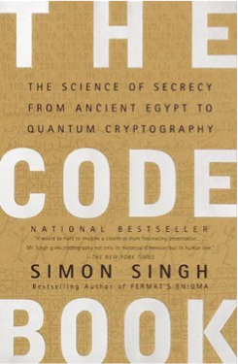
Pieces of History

Slide 12
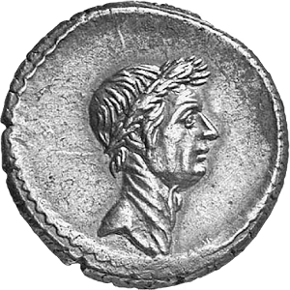
Historic ciphers
Caesar Cipher
Vigenère Cipher

Slide 13
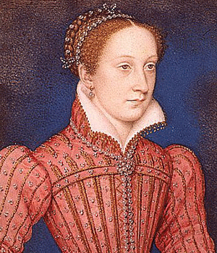
Mary Queen of Scots
Trial against Queen Elizabeth
Was executed after her code was broken (1587)
Notes:
Mary, Queen of Scots (7/8 December 1542 – 8 February 1587), also known as Mary Stuart[3] or Mary I of Scotland, was queen regnant of Scotland from 14 December 1542 to 24 July 1567 and queen consort of France from 10 July 1559 to 5 December 1560.
Mary, the only surviving legitimate child of King James V of Scotland, was 6 days old when her father died and she acceded to the throne. She spent most of her childhood in France while Scotland was ruled by regents, and in 1558, she married the Dauphin of France, Francis. He ascended the French throne as King Francis II in 1559, and Mary briefly became queen consort of France, until his death on 5 December 1560. Widowed, Mary returned to Scotland, arriving in Leith on 19 August 1561. Four years later, she married her first cousin, Henry Stuart, Lord Darnley, but their union was unhappy. In February 1567, his residence was destroyed by an explosion, and Darnley was found murdered in the garden.
James Hepburn, 4th Earl of Bothwell, was generally believed to have orchestrated Darnley's death, but he was acquitted of the charge in April 1567, and the following month he married Mary. Following an uprising against the couple, Mary was imprisoned in Loch Leven Castle. On 24 July 1567, she was forced to abdicate in favour of James, her one-year-old son by Darnley. After an unsuccessful attempt to regain the throne, she fled southwards seeking the protection of her first cousin once removed, Queen Elizabeth I of England. Mary had previously claimed Elizabeth's throne as her own and was considered the legitimate sovereign of England by many English Catholics, including participants in a rebellion known as the Rising of the North. Perceiving her as a threat, Elizabeth had her confined in various castles and manor houses in the interior of England. After eighteen and a half years in custody, Mary was found guilty of plotting to assassinate Elizabeth, and was subsequently executed.
(ref: http://en.wikipedia.org/wiki/Mary,_Queen_of_Scots)

Slide 14
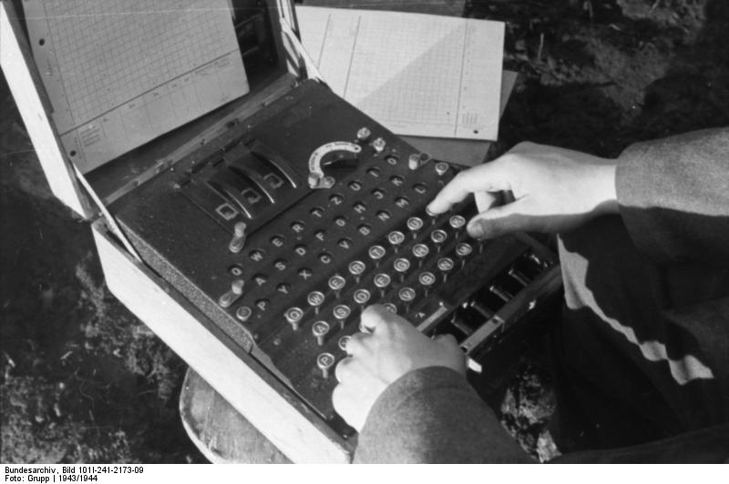
Enigma
Secret in code book

Slide 15
BetterCrypto

Slide 16
Why?
Crypto is cryptic
A lot of difficult concepts
A lot of algorithms
A lot of parameters
…

Slide 17
The Idea
Really difficult for systems administrators
A “cookbook” can help!
That’s BetterCrypo

Slide 18
That’s not…
A crypto course
A static document

Slide 19
In brief
Community effort to produce best common practices for typical servers
Continuous effort
From diverse areas of expertise: sysadmins, cryptologists, developers, IT security pros
Open Source (CC-BY-SA)
Open to comments / suggestions / improvements

Slide 20
2 parts
First part = configurations
The most important part
Cover as many tools as possible
Second part = theory
Explain and justify choose we made
Transparency

Slide 21
How to use the bettercrypto guide?

Slide 22
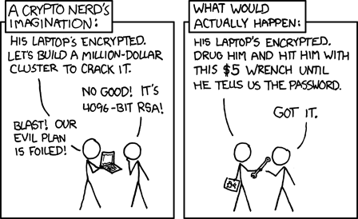
Crypto in a nutshell

Slide 23
Goals
2 types of goals:
protect the content of the message
Eavesdropping
Tampering
identify the author (signatures)
At least the one who controls the key
Can be combined

Slide 24
Symmetric Crypto
The key is shared

Slide 25
Asymmetric Crypto
Public key is published
Private key HAS to be secured

Slide 26
Signing
Author’s identity is proved
Signed with the private key

Slide 27
Diffie-Helleman
How to share a secret key?

Slide 28
Ephemeral Diffie-Helleman
Regular mode
Public and private keys are kept
Ephemeral mode
New keys are generated each time
By both parties

Slide 29
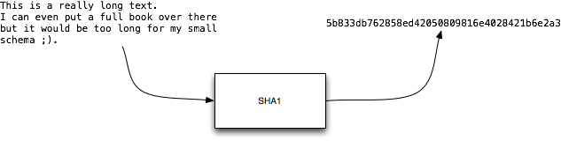
Hashing
Take long piece of data and produce a probably unique fingerprint
Probability of collision for SHA1:
1 over 1461501637330902918203684832716283019655932542976

Slide 30
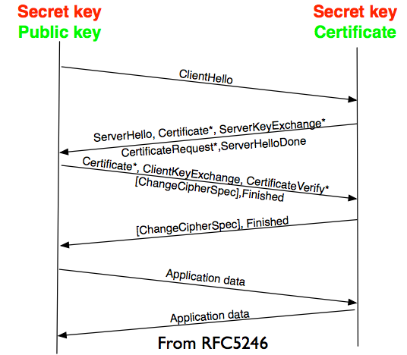
TLS
• Hello includes
• Random number
• Cipher suite
• Finished
• 1st cipher message with
negotiated parameters
• Algorithm
• Key
• Secret

Slide 31

Forward Secrecy-Motivation:
Lavabit example
Three letter agency (TLA) stores all ssl traffic
Someday TLA gains access to ssl-private key (Brute Force, Physical Force)
TLA can decrypt all stored traffic

Slide 32
Perfect Forward Secrecy
DHE: Diffie Hellman Ephemeral
Ephemeral: new key for each execution of a key exchange process
SSL private-Key only for authentication
Alternative new ssl private key every x days months
Pro:
Highest Security against future attacks
Contra:
Processing costs

Slide 33
Stream vs Block Cipher
Stream cipher
Generate an “infinite” key stream
Difficult to correctly use
Re-use of keys
Faster
Block cipher
Encrypt by block with padding
Could include integrity protection

Slide 34
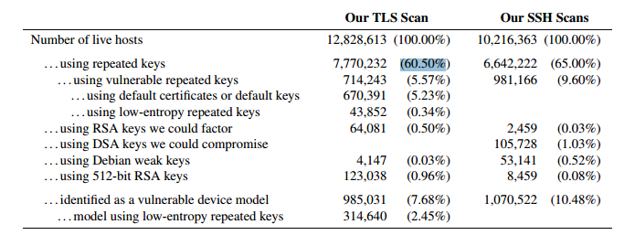
RNGs
RNGs are important.
Nadia Heninger et al / Lenstra et al
Entropy after startup: embedded devices

Slide 35
(p)RNGs
Weak RNG
Dual EC_DRBG is BROKEN (backdoored, used in RSA-toolkit)
Intel RNG ? Recommendation: add System-Entropy (Network). Entropy only goes up.
Tools (eg. HaveGE http://dl.acm.org/citation.cfm?id=945516)
RTFM
when is the router key generated
Default Keys ?
Re-generate keys from time to time

Slide 36
Some algorithms
Symetric Ciphering
AES (Rijndael)
Camellia
Asymetric Ciphering
RSA
PGP (GPG)

Slide 37
Some algorithms
Hash
SHA1
SHA256
SHA512
Key Exchange
Diffie Helleman

Slide 38
Algorithm vs Implementation!
Heartbleed
Debian bug in Openssl (randomness was commented out)

Slide 39
Cost of encryption
$ time openssl enc -e -a -aes-128-cbc -in ./rfc791.txt \ -out /tmp/rfc.aes -k "Super Key" -S 01EF
real 0m0.014s
user 0m0.004s
sys 0m0.003s
$ time gpg -a -u 57AB3358 -r 77659F3E -e ./rfc791.txt
real 0m0.069s
user 0m0.048s
sys 0m0.008s
GPG is 4,93 time slower!
Notes:
$ openssl enc -a -aes-128-cbc -in /tmp/demo.msg -out /tmp/demo.aes -k "Super Key" -S 01EF –e
$ openssl enc -a -aes-128-cbc -out /tmp/demo-back.msg -in /tmp/demo.aes -k "Super Key" -S 01EF –d
GPG key of 4096bits vs 128 bits AES encryption
Demo file is the IP RFC ;)
-- DEMO !! --

Slide 40
Keylengths
On the choice between AES256 and AES128: I would never consider using AES256, just like I don’t wear a helmet when I sit inside my car. It’s too much bother for the epsilon improvement in security.”
— Vincent Rijmen in a personal mail exchange Dec 2013

Slide 41
Keylengths
http://www.keylength.com/
Recommended Keylengths, Hashing algorithms, etc.
Currently:
RSA: >= 3248 bits (Ecrypt II)
ECC: >= 256
SHA 2+ (SHA 256,…)
AES 128 is good enough

Slide 42
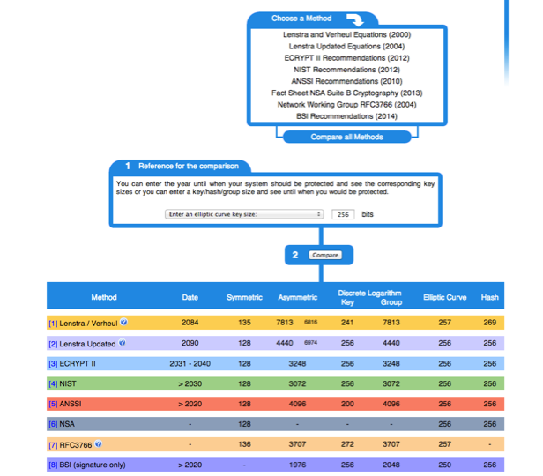

Slide 43
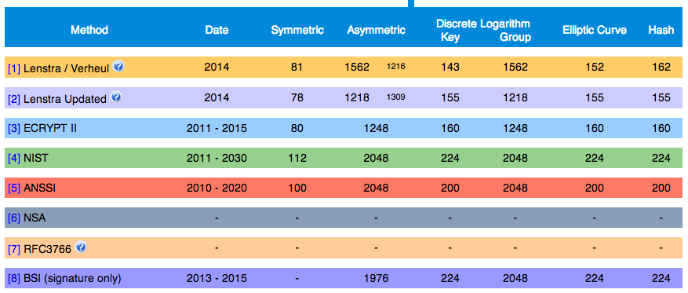

Slide 44
BetterCrypto CipherSuite
2 cipher suites
version A
stronger
fewer supported clients
version B
weaker
more “universal”

Slide 45
Some general thoughts on settings
General
Disable SSL 2.0 (weak algorithms)
Disable SSL 3.0 (BEAST vs IE/XP)
Enable TLS 1.0 or preferably better
Disable TLS-Compression (SSL-CRIME Attack)
Implement HSTS (HTTP Strict Transport Security)

Slide 46
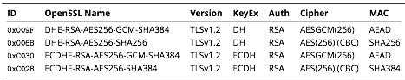
Cipher Suite A
TLS 1.2
Perfect forward secrecy / ephemeral Diffie Hellman
Strong MACs (SHA-2) or
GCM as Authenticated Encryption scheme

Slide 47
CiperSuite B
TLS 1.2, TLS 1.1, TLS 1.0
Allowing SHA-1

Slide 48
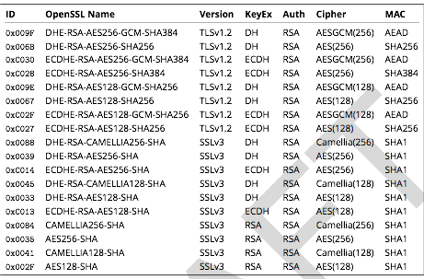
Cipher Suite B

Slide 49
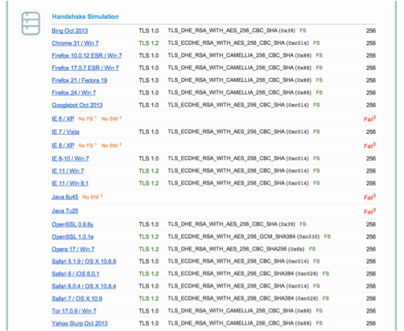
Compatibility (B suite)

Slide 50
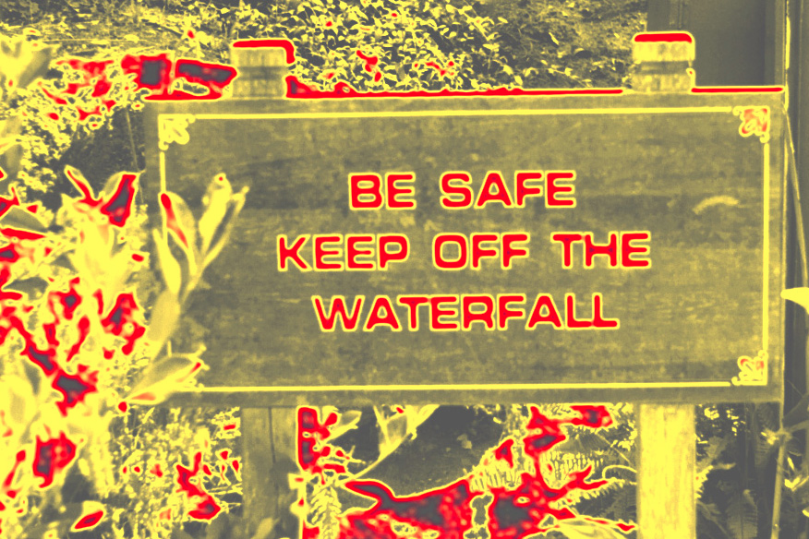
Practical Settings

Slide 51
Tools covered
Webservers
Apache
lighttpd
nginx
Microsoft IIS

Slide 52
Tools covered
SSH
Open SSH
Cisco ASA
Cisco IOS

Slide 53
Tools covered
Mail servers
Dovecot
cyrus-imapd
Postfix
Exim

Slide 54
Tools covered
VPN
IPSec
CheckPoint Firewall-1
OpenVPN
PPPTP
Cisco ASA
OpenSWAN
tinc

Slide 55
Tools covered
PGP/GPG
IPMI/ILO
Instant Messaging
ejabberd
OTR
Charybdis
SILC

Slide 56
Tools covered
Database systems
Oracle
MySQL
DB2
PostgreSQL

Slide 57
Tools covered
Proxy
squid
Bluecoat
Pound
Kerberos

Slide 58
Mail Encryption
GPG / PGP – end to end protection
Use public / private crypto to protect your emails
Chain of trust
Independent of the mail client / transport layer
Can be used to verify author and/or protect content
STARTTLS for SMTP – in transit

Slide 59
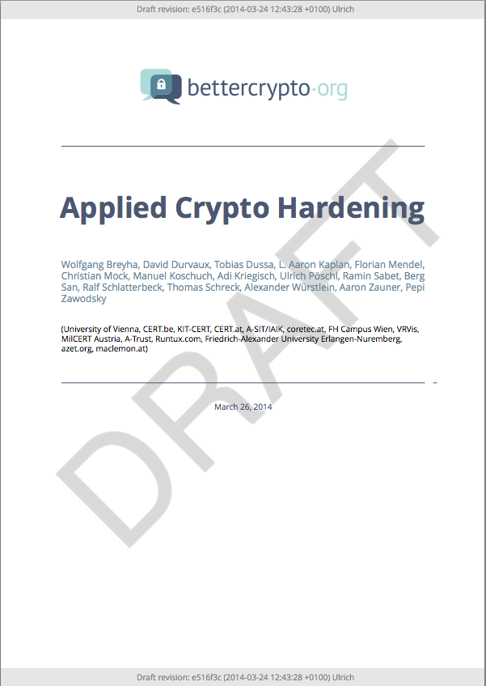
Let’s have a look

Slide 60
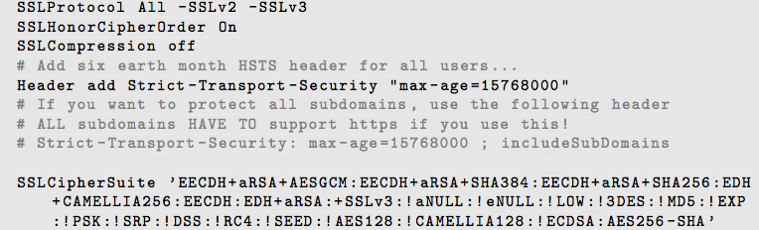
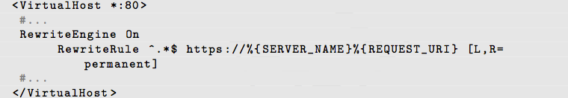
Apache
Selecting cipher suites:
Additionally:
Aaron

Slide 61
Mail Server
SMTP make use of opportunistic TLS
3 modes for mailservers
Mail Submission Agent (MSA)
Receiving Mail Transmission Agent (MX)
Sending Mail Transmission Agent (SMTP client)

Slide 62
Mail Server
Correct DNS configuration without CNAMEs
Enable encryption
NO self-signed certificates

Slide 63
SMTP client mode
Hostname used as HELO must match the PTR RR
Setup a client certificate
Common name or alternate subject name must match the PTR RR
Don‘t touch cipher suite

Slide 64
MSA
Listen on port 587
Enforce SMTP AUTH
No SMTP AUTH on unencrypted connections
(use recommended cipher suites)

Slide 65
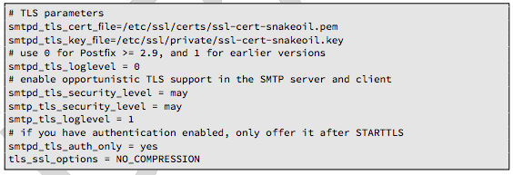
Postfix: MX & SMTP client
In main.cf
Enable opportunistic TLS

Slide 66
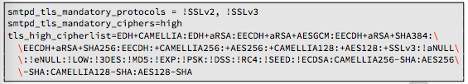
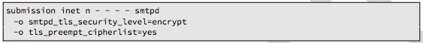
Postfix: MSA
Define ciper suite:
Configure MSA SMTP:

Slide 67
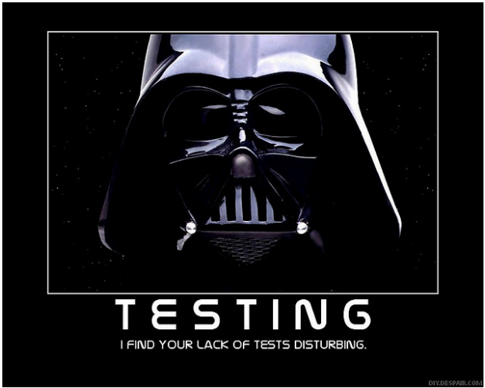
Testing

Slide 68
How to test? - Tools
openssl s_client (or gnutls-cli)
ssllabs.com: checks for servers as well as clients
xmpp.net
sslscan
SSLyze

Slide 69
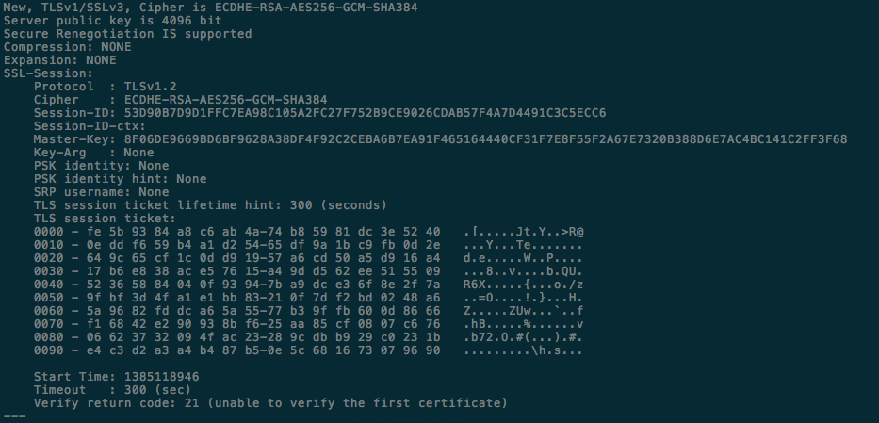
Tools: openssl s_client
openssl s_client -showcerts –connect git.bettercrypto.org:443
Notes:
$ openssl s_client -connect www.google.be:443
CONNECTED(00000003)
depth=2 C = US, O = GeoTrust Inc., CN = GeoTrust Global CA
verify error:num=20:unable to get local issuer certificate
verify return:0
---
Certificate chain
0 s:/C=US/ST=California/L=Mountain View/O=Google Inc/CN=google.com
i:/C=US/O=Google Inc/CN=Google Internet Authority G2
1 s:/C=US/O=Google Inc/CN=Google Internet Authority G2
i:/C=US/O=GeoTrust Inc./CN=GeoTrust Global CA
2 s:/C=US/O=GeoTrust Inc./CN=GeoTrust Global CA
i:/C=US/O=Equifax/OU=Equifax Secure Certificate Authority
---
Server certificate
-----BEGIN CERTIFICATE-----
MIIe9TCCHd2gAwIBAgIIeF9zqFHWa9AwDQYJKoZIhvcNAQEFBQAwSTELMAkGA1UE
BhMCVVMxEzARBgNVBAoTCkdvb2dsZSBJbmMxJTAjBgNVBAMTHEdvb2dsZSBJbnRl
cm5ldCBBdXRob3JpdHkgRzIwHhcNMTQwNTIyMTIwMTU1WhcNMTQwODIwMDAwMDAw
WjBkMQswCQYDVQQGEwJVUzETMBEGA1UECAwKQ2FsaWZvcm5pYTEWMBQGA1UEBwwN
TW91bnRhaW4gVmlldzETMBEGA1UECgwKR29vZ2xlIEluYzETMBEGA1UEAwwKZ29v
Z2xlLmNvbTCCASIwDQYJKoZIhvcNAQEBBQADggEPADCCAQoCggEBAM++97DV7qFH
w4YOMd80UZomaQ8r0zWEtMOUnweKBuQHDQ5Ue7gZSASfLs+bXV4aIlkAXWmObAOE
3KLayDqvNrBq2P5bNu4kdvE47r+b40ZA6mvP47KV47kxES9Uxpfse/u1I1oAyaQp
8gfK7RvJrCbA2Poz3NuJ0AmovLb7dCWg4piJ52gKjSJc/G7YIYj7llBsCONZtogF
zCu6C0d8iDN269LCoVX9oJ/c76hnw4+eJSGTA/U5PDTIIxjzWikKxhbT7Gd3wDx4
k88DLFY5uSoePEcUtjfBl4nCQvQ1Eh8uOkHq0qmYX5PqC4DTtiowR8ICChBETABu
AKHOuyvtJ9sCAwEAAaOCG8QwghvAMB0GA1UdJQQWMBQGCCsGAQUFBwMBBggrBgEF
BQcDAjCCGpoGA1UdEQSCGpEwghqNggpnb29nbGUuY29tggoqLjJtZG4ubmV0gg0q
LmFuZHJvaWQuY29tghYqLmFwcGVuZ2luZS5nb29nbGUuY29tghQqLmF1LmRvdWJs
ZWNsaWNrLm5ldIILKi5jYy1kdC5jb22CEiouY2xvdWQuZ29vZ2xlLmNvbYIUKi5k
ZS5kb3VibGVjbGljay5uZXSCESouZG91YmxlY2xpY2suY29tghEqLmRvdWJsZWNs
aWNrLm5ldIIVKi5mbHMuZG91YmxlY2xpY2submV0ghQqLmZyLmRvdWJsZWNsaWNr
Lm5ldIIWKi5nb29nbGUtYW5hbHl0aWNzLmNvbYILKi5nb29nbGUuYWOCCyouZ29v
Z2xlLmFkggsqLmdvb2dsZS5hZYILKi5nb29nbGUuYWaCCyouZ29vZ2xlLmFnggsq
Lmdvb2dsZS5hbIILKi5nb29nbGUuYW2CCyouZ29vZ2xlLmFzggsqLmdvb2dsZS5h
dIILKi5nb29nbGUuYXqCCyouZ29vZ2xlLmJhggsqLmdvb2dsZS5iZYILKi5nb29n
bGUuYmaCCyouZ29vZ2xlLmJnggsqLmdvb2dsZS5iaYILKi5nb29nbGUuYmqCCyou
Z29vZ2xlLmJzggsqLmdvb2dsZS5idIILKi5nb29nbGUuYnmCCyouZ29vZ2xlLmNh
ggwqLmdvb2dsZS5jYXSCCyouZ29vZ2xlLmNjggsqLmdvb2dsZS5jZIILKi5nb29n
bGUuY2aCCyouZ29vZ2xlLmNnggsqLmdvb2dsZS5jaIILKi5nb29nbGUuY2mCCyou
Z29vZ2xlLmNsggsqLmdvb2dsZS5jbYILKi5nb29nbGUuY26CDiouZ29vZ2xlLmNv
LmFvgg4qLmdvb2dsZS5jby5id4IOKi5nb29nbGUuY28uY2uCDiouZ29vZ2xlLmNv
LmNygg4qLmdvb2dsZS5jby5odYIOKi5nb29nbGUuY28uaWSCDiouZ29vZ2xlLmNv
Lmlsgg4qLmdvb2dsZS5jby5pbYIOKi5nb29nbGUuY28uaW6CDiouZ29vZ2xlLmNv
Lmplgg4qLmdvb2dsZS5jby5qcIIOKi5nb29nbGUuY28ua2WCDiouZ29vZ2xlLmNv
Lmtygg4qLmdvb2dsZS5jby5sc4IOKi5nb29nbGUuY28ubWGCDiouZ29vZ2xlLmNv
Lm16gg4qLmdvb2dsZS5jby5ueoIOKi5nb29nbGUuY28udGiCDiouZ29vZ2xlLmNv
LnR6gg4qLmdvb2dsZS5jby51Z4IOKi5nb29nbGUuY28udWuCDiouZ29vZ2xlLmNv
LnV6gg4qLmdvb2dsZS5jby52ZYIOKi5nb29nbGUuY28udmmCDiouZ29vZ2xlLmNv
Lnphgg4qLmdvb2dsZS5jby56bYIOKi5nb29nbGUuY28ueneCDCouZ29vZ2xlLmNv
bYIPKi5nb29nbGUuY29tLmFmgg8qLmdvb2dsZS5jb20uYWeCDyouZ29vZ2xlLmNv
bS5haYIPKi5nb29nbGUuY29tLmFygg8qLmdvb2dsZS5jb20uYXWCDyouZ29vZ2xl
LmNvbS5iZIIPKi5nb29nbGUuY29tLmJogg8qLmdvb2dsZS5jb20uYm6CDyouZ29v
Z2xlLmNvbS5ib4IPKi5nb29nbGUuY29tLmJygg8qLmdvb2dsZS5jb20uYnmCDyou
Z29vZ2xlLmNvbS5ieoIPKi5nb29nbGUuY29tLmNugg8qLmdvb2dsZS5jb20uY2+C
DyouZ29vZ2xlLmNvbS5jdYIPKi5nb29nbGUuY29tLmN5gg8qLmdvb2dsZS5jb20u
ZG+CDyouZ29vZ2xlLmNvbS5lY4IPKi5nb29nbGUuY29tLmVngg8qLmdvb2dsZS5j
b20uZXSCDyouZ29vZ2xlLmNvbS5maoIPKi5nb29nbGUuY29tLmdlgg8qLmdvb2ds
ZS5jb20uZ2iCDyouZ29vZ2xlLmNvbS5naYIPKi5nb29nbGUuY29tLmdygg8qLmdv
b2dsZS5jb20uZ3SCDyouZ29vZ2xlLmNvbS5oa4IPKi5nb29nbGUuY29tLmlxgg8q
Lmdvb2dsZS5jb20uam2CDyouZ29vZ2xlLmNvbS5qb4IPKi5nb29nbGUuY29tLmto
gg8qLmdvb2dsZS5jb20ua3eCDyouZ29vZ2xlLmNvbS5sYoIPKi5nb29nbGUuY29t
Lmx5gg8qLmdvb2dsZS5jb20ubW2CDyouZ29vZ2xlLmNvbS5tdIIPKi5nb29nbGUu
Y29tLm14gg8qLmdvb2dsZS5jb20ubXmCDyouZ29vZ2xlLmNvbS5uYYIPKi5nb29n
bGUuY29tLm5mgg8qLmdvb2dsZS5jb20ubmeCDyouZ29vZ2xlLmNvbS5uaYIPKi5n
b29nbGUuY29tLm5wgg8qLmdvb2dsZS5jb20ubnKCDyouZ29vZ2xlLmNvbS5vbYIP
Ki5nb29nbGUuY29tLnBhgg8qLmdvb2dsZS5jb20ucGWCDyouZ29vZ2xlLmNvbS5w
Z4IPKi5nb29nbGUuY29tLnBogg8qLmdvb2dsZS5jb20ucGuCDyouZ29vZ2xlLmNv
bS5wbIIPKi5nb29nbGUuY29tLnBygg8qLmdvb2dsZS5jb20ucHmCDyouZ29vZ2xl
LmNvbS5xYYIPKi5nb29nbGUuY29tLnJ1gg8qLmdvb2dsZS5jb20uc2GCDyouZ29v
Z2xlLmNvbS5zYoIPKi5nb29nbGUuY29tLnNngg8qLmdvb2dsZS5jb20uc2yCDyou
Z29vZ2xlLmNvbS5zdoIPKi5nb29nbGUuY29tLnRqgg8qLmdvb2dsZS5jb20udG6C
DyouZ29vZ2xlLmNvbS50coIPKi5nb29nbGUuY29tLnR3gg8qLmdvb2dsZS5jb20u
dWGCDyouZ29vZ2xlLmNvbS51eYIPKi5nb29nbGUuY29tLnZjgg8qLmdvb2dsZS5j
b20udmWCDyouZ29vZ2xlLmNvbS52boILKi5nb29nbGUuY3aCCyouZ29vZ2xlLmN6
ggsqLmdvb2dsZS5kZYILKi5nb29nbGUuZGqCCyouZ29vZ2xlLmRrggsqLmdvb2ds
ZS5kbYILKi5nb29nbGUuZHqCCyouZ29vZ2xlLmVlggsqLmdvb2dsZS5lc4ILKi5n
b29nbGUuZmmCCyouZ29vZ2xlLmZtggsqLmdvb2dsZS5mcoILKi5nb29nbGUuZ2GC
CyouZ29vZ2xlLmdlggsqLmdvb2dsZS5nZ4ILKi5nb29nbGUuZ2yCCyouZ29vZ2xl
LmdtggsqLmdvb2dsZS5ncIILKi5nb29nbGUuZ3KCCyouZ29vZ2xlLmd5ggsqLmdv
b2dsZS5oa4ILKi5nb29nbGUuaG6CCyouZ29vZ2xlLmhyggsqLmdvb2dsZS5odIIL
Ki5nb29nbGUuaHWCCyouZ29vZ2xlLmllggsqLmdvb2dsZS5pbYINKi5nb29nbGUu
aW5mb4ILKi5nb29nbGUuaXGCCyouZ29vZ2xlLmlyggsqLmdvb2dsZS5pc4ILKi5n
b29nbGUuaXSCDiouZ29vZ2xlLml0LmFvggsqLmdvb2dsZS5qZYILKi5nb29nbGUu
am+CDSouZ29vZ2xlLmpvYnOCCyouZ29vZ2xlLmpwggsqLmdvb2dsZS5rZ4ILKi5n
b29nbGUua2mCCyouZ29vZ2xlLmt6ggsqLmdvb2dsZS5sYYILKi5nb29nbGUubGmC
CyouZ29vZ2xlLmxrggsqLmdvb2dsZS5sdIILKi5nb29nbGUubHWCCyouZ29vZ2xl
Lmx2ggsqLmdvb2dsZS5tZIILKi5nb29nbGUubWWCCyouZ29vZ2xlLm1nggsqLmdv
b2dsZS5ta4ILKi5nb29nbGUubWyCCyouZ29vZ2xlLm1uggsqLmdvb2dsZS5tc4IL
Ki5nb29nbGUubXWCCyouZ29vZ2xlLm12ggsqLmdvb2dsZS5td4ILKi5nb29nbGUu
bmWCDiouZ29vZ2xlLm5lLmpwggwqLmdvb2dsZS5uZXSCCyouZ29vZ2xlLm5nggsq
Lmdvb2dsZS5ubIILKi5nb29nbGUubm+CCyouZ29vZ2xlLm5yggsqLmdvb2dsZS5u
dYIPKi5nb29nbGUub2ZmLmFpggsqLmdvb2dsZS5wa4ILKi5nb29nbGUucGyCCyou
Z29vZ2xlLnBuggsqLmdvb2dsZS5wc4ILKi5nb29nbGUucHSCCyouZ29vZ2xlLnJv
ggsqLmdvb2dsZS5yc4ILKi5nb29nbGUucnWCCyouZ29vZ2xlLnJ3ggsqLmdvb2ds
ZS5zY4ILKi5nb29nbGUuc2WCCyouZ29vZ2xlLnNoggsqLmdvb2dsZS5zaYILKi5n
b29nbGUuc2uCCyouZ29vZ2xlLnNtggsqLmdvb2dsZS5zboILKi5nb29nbGUuc2+C
CyouZ29vZ2xlLnNyggsqLmdvb2dsZS5zdIILKi5nb29nbGUudGSCCyouZ29vZ2xl
LnRnggsqLmdvb2dsZS50a4ILKi5nb29nbGUudGyCCyouZ29vZ2xlLnRtggsqLmdv
b2dsZS50boILKi5nb29nbGUudG+CCyouZ29vZ2xlLnR0ggsqLmdvb2dsZS51c4IL
Ki5nb29nbGUudXqCCyouZ29vZ2xlLnZnggsqLmdvb2dsZS52dYILKi5nb29nbGUu
d3OCDyouZ29vZ2xlYXBpcy5jboIUKi5nb29nbGVjb21tZXJjZS5jb22CESouZ29v
Z2xldmlkZW8uY29tgg0qLmdzdGF0aWMuY29tggoqLmd2dDEuY29tghQqLmpwLmRv
dWJsZWNsaWNrLm5ldIIUKi5tZXRyaWMuZ3N0YXRpYy5jb22CFCoudWsuZG91Ymxl
Y2xpY2submV0ggwqLnVyY2hpbi5jb22CECoudXJsLmdvb2dsZS5jb22CFioueW91
dHViZS1ub2Nvb2tpZS5jb22CDSoueW91dHViZS5jb22CFioueW91dHViZWVkdWNh
dGlvbi5jb22CCyoueXRpbWcuY29tghVhZC5tby5kb3VibGVjbGljay5uZXSCC2Fu
ZHJvaWQuY29tgg9kb3VibGVjbGljay5uZXSCBGcuY2+CBmdvby5nbIIUZ29vZ2xl
LWFuYWx5dGljcy5jb22CCWdvb2dsZS5hY4IJZ29vZ2xlLmFkgglnb29nbGUuYWWC
CWdvb2dsZS5hZoIJZ29vZ2xlLmFngglnb29nbGUuYWyCCWdvb2dsZS5hbYIJZ29v
Z2xlLmFzgglnb29nbGUuYXSCCWdvb2dsZS5heoIJZ29vZ2xlLmJhgglnb29nbGUu
YmWCCWdvb2dsZS5iZoIJZ29vZ2xlLmJngglnb29nbGUuYmmCCWdvb2dsZS5iaoIJ
Z29vZ2xlLmJzgglnb29nbGUuYnSCCWdvb2dsZS5ieYIJZ29vZ2xlLmNhggpnb29n
bGUuY2F0gglnb29nbGUuY2OCCWdvb2dsZS5jZIIJZ29vZ2xlLmNmgglnb29nbGUu
Y2eCCWdvb2dsZS5jaIIJZ29vZ2xlLmNpgglnb29nbGUuY2yCCWdvb2dsZS5jbYIJ
Z29vZ2xlLmNuggxnb29nbGUuY28uYW+CDGdvb2dsZS5jby5id4IMZ29vZ2xlLmNv
LmNrggxnb29nbGUuY28uY3KCDGdvb2dsZS5jby5odYIMZ29vZ2xlLmNvLmlkggxn
b29nbGUuY28uaWyCDGdvb2dsZS5jby5pbYIMZ29vZ2xlLmNvLmluggxnb29nbGUu
Y28uamWCDGdvb2dsZS5jby5qcIIMZ29vZ2xlLmNvLmtlggxnb29nbGUuY28ua3KC
DGdvb2dsZS5jby5sc4IMZ29vZ2xlLmNvLm1hggxnb29nbGUuY28ubXqCDGdvb2ds
ZS5jby5ueoIMZ29vZ2xlLmNvLnRoggxnb29nbGUuY28udHqCDGdvb2dsZS5jby51
Z4IMZ29vZ2xlLmNvLnVrggxnb29nbGUuY28udXqCDGdvb2dsZS5jby52ZYIMZ29v
Z2xlLmNvLnZpggxnb29nbGUuY28uemGCDGdvb2dsZS5jby56bYIMZ29vZ2xlLmNv
Lnp3gg1nb29nbGUuY29tLmFmgg1nb29nbGUuY29tLmFngg1nb29nbGUuY29tLmFp
gg1nb29nbGUuY29tLmFygg1nb29nbGUuY29tLmF1gg1nb29nbGUuY29tLmJkgg1n
b29nbGUuY29tLmJogg1nb29nbGUuY29tLmJugg1nb29nbGUuY29tLmJvgg1nb29n
bGUuY29tLmJygg1nb29nbGUuY29tLmJ5gg1nb29nbGUuY29tLmJ6gg1nb29nbGUu
Y29tLmNugg1nb29nbGUuY29tLmNvgg1nb29nbGUuY29tLmN1gg1nb29nbGUuY29t
LmN5gg1nb29nbGUuY29tLmRvgg1nb29nbGUuY29tLmVjgg1nb29nbGUuY29tLmVn
gg1nb29nbGUuY29tLmV0gg1nb29nbGUuY29tLmZqgg1nb29nbGUuY29tLmdlgg1n
b29nbGUuY29tLmdogg1nb29nbGUuY29tLmdpgg1nb29nbGUuY29tLmdygg1nb29n
bGUuY29tLmd0gg1nb29nbGUuY29tLmhrgg1nb29nbGUuY29tLmlxgg1nb29nbGUu
Y29tLmptgg1nb29nbGUuY29tLmpvgg1nb29nbGUuY29tLmtogg1nb29nbGUuY29t
Lmt3gg1nb29nbGUuY29tLmxigg1nb29nbGUuY29tLmx5gg1nb29nbGUuY29tLm1t
gg1nb29nbGUuY29tLm10gg1nb29nbGUuY29tLm14gg1nb29nbGUuY29tLm15gg1n
b29nbGUuY29tLm5hgg1nb29nbGUuY29tLm5mgg1nb29nbGUuY29tLm5ngg1nb29n
bGUuY29tLm5pgg1nb29nbGUuY29tLm5wgg1nb29nbGUuY29tLm5ygg1nb29nbGUu
Y29tLm9tgg1nb29nbGUuY29tLnBhgg1nb29nbGUuY29tLnBlgg1nb29nbGUuY29t
LnBngg1nb29nbGUuY29tLnBogg1nb29nbGUuY29tLnBrgg1nb29nbGUuY29tLnBs
gg1nb29nbGUuY29tLnBygg1nb29nbGUuY29tLnB5gg1nb29nbGUuY29tLnFhgg1n
b29nbGUuY29tLnJ1gg1nb29nbGUuY29tLnNhgg1nb29nbGUuY29tLnNigg1nb29n
bGUuY29tLnNngg1nb29nbGUuY29tLnNsgg1nb29nbGUuY29tLnN2gg1nb29nbGUu
Y29tLnRqgg1nb29nbGUuY29tLnRugg1nb29nbGUuY29tLnRygg1nb29nbGUuY29t
LnR3gg1nb29nbGUuY29tLnVhgg1nb29nbGUuY29tLnV5gg1nb29nbGUuY29tLnZj
gg1nb29nbGUuY29tLnZlgg1nb29nbGUuY29tLnZugglnb29nbGUuY3aCCWdvb2ds
ZS5jeoIJZ29vZ2xlLmRlgglnb29nbGUuZGqCCWdvb2dsZS5ka4IJZ29vZ2xlLmRt
gglnb29nbGUuZHqCCWdvb2dsZS5lZYIJZ29vZ2xlLmVzgglnb29nbGUuZmmCCWdv
b2dsZS5mbYIJZ29vZ2xlLmZygglnb29nbGUuZ2GCCWdvb2dsZS5nZYIJZ29vZ2xl
Lmdngglnb29nbGUuZ2yCCWdvb2dsZS5nbYIJZ29vZ2xlLmdwgglnb29nbGUuZ3KC
CWdvb2dsZS5neYIJZ29vZ2xlLmhrgglnb29nbGUuaG6CCWdvb2dsZS5ocoIJZ29v
Z2xlLmh0gglnb29nbGUuaHWCCWdvb2dsZS5pZYIJZ29vZ2xlLmltggtnb29nbGUu
aW5mb4IJZ29vZ2xlLmlxgglnb29nbGUuaXKCCWdvb2dsZS5pc4IJZ29vZ2xlLml0
ggxnb29nbGUuaXQuYW+CCWdvb2dsZS5qZYIJZ29vZ2xlLmpvggtnb29nbGUuam9i
c4IJZ29vZ2xlLmpwgglnb29nbGUua2eCCWdvb2dsZS5raYIJZ29vZ2xlLmt6ggln
b29nbGUubGGCCWdvb2dsZS5saYIJZ29vZ2xlLmxrgglnb29nbGUubHSCCWdvb2ds
ZS5sdYIJZ29vZ2xlLmx2gglnb29nbGUubWSCCWdvb2dsZS5tZYIJZ29vZ2xlLm1n
gglnb29nbGUubWuCCWdvb2dsZS5tbIIJZ29vZ2xlLm1ugglnb29nbGUubXOCCWdv
b2dsZS5tdYIJZ29vZ2xlLm12gglnb29nbGUubXeCCWdvb2dsZS5uZYIMZ29vZ2xl
Lm5lLmpwggpnb29nbGUubmV0gglnb29nbGUubmeCCWdvb2dsZS5ubIIJZ29vZ2xl
Lm5vgglnb29nbGUubnKCCWdvb2dsZS5udYINZ29vZ2xlLm9mZi5haYIJZ29vZ2xl
LnBrgglnb29nbGUucGyCCWdvb2dsZS5wboIJZ29vZ2xlLnBzgglnb29nbGUucHSC
CWdvb2dsZS5yb4IJZ29vZ2xlLnJzgglnb29nbGUucnWCCWdvb2dsZS5yd4IJZ29v
Z2xlLnNjgglnb29nbGUuc2WCCWdvb2dsZS5zaIIJZ29vZ2xlLnNpgglnb29nbGUu
c2uCCWdvb2dsZS5zbYIJZ29vZ2xlLnNugglnb29nbGUuc2+CCWdvb2dsZS5zcoIJ
Z29vZ2xlLnN0gglnb29nbGUudGSCCWdvb2dsZS50Z4IJZ29vZ2xlLnRrgglnb29n
bGUudGyCCWdvb2dsZS50bYIJZ29vZ2xlLnRugglnb29nbGUudG+CCWdvb2dsZS50
dIIJZ29vZ2xlLnVzgglnb29nbGUudXqCCWdvb2dsZS52Z4IJZ29vZ2xlLnZ1ggln
b29nbGUud3OCEmdvb2dsZWNvbW1lcmNlLmNvbYILZ3N0YXRpYy5jb22CCnVyY2hp
bi5jb22CCHlvdXR1LmJlggt5b3V0dWJlLmNvbYIUeW91dHViZWVkdWNhdGlvbi5j
b20waAYIKwYBBQUHAQEEXDBaMCsGCCsGAQUFBzAChh9odHRwOi8vcGtpLmdvb2ds
ZS5jb20vR0lBRzIuY3J0MCsGCCsGAQUFBzABhh9odHRwOi8vY2xpZW50czEuZ29v
Z2xlLmNvbS9vY3NwMB0GA1UdDgQWBBTtiEqfC1Uu68IDfSydP/J6JwcLwzAMBgNV
HRMBAf8EAjAAMB8GA1UdIwQYMBaAFErdBhYbvPZotXb1gba7Yhq6WoEvMBcGA1Ud
IAQQMA4wDAYKKwYBBAHWeQIFATAwBgNVHR8EKTAnMCWgI6Ahhh9odHRwOi8vcGtp
Lmdvb2dsZS5jb20vR0lBRzIuY3JsMA0GCSqGSIb3DQEBBQUAA4IBAQBF19oEIHeG
5m/Vdnx1rLCLmKVhPxi2KPDbKx1VqfY7VwkeH5lh5bU2vbymBCjupmCWvo7ITR6a
HHtVNxVH/PgwCpku9xmW+4PubBzvH1oza9mHe7QBoVoqp1eXIm8XnVvKawr0hhXc
FMT4bbKC/qP/DJw+8tv91sw/mT1ZPGqXzp1/yQVCsm13lSSQ4tb6XoELtiqiFKX6
bvhJj4iwoNBSIIzJ8t1VWqETJY/xkulj4cOXtAc5JeIZc3Jf++XVdIhBF1NSa1tv
peRO5c4OWf8+QSuQlvmY3XCqFb1WCj5HKOoA0AXNpOGwK8L5DTMmtgPwdzHhNcmI
pKkMwwxBWC3W
-----END CERTIFICATE-----
subject=/C=US/ST=California/L=Mountain View/O=Google Inc/CN=google.com
issuer=/C=US/O=Google Inc/CN=Google Internet Authority G2
---
No client certificate CA names sent
---
SSL handshake has read 10522 bytes and written 643 bytes
---
New, TLSv1/SSLv3, Cipher is ECDHE-RSA-AES128-GCM-SHA256
Server public key is 2048 bit
Secure Renegotiation IS supported
Compression: NONE
Expansion: NONE
SSL-Session:
Protocol : TLSv1.2
Cipher : ECDHE-RSA-AES128-GCM-SHA256
Session-ID: 6207DB2C79FD5D983BF0B264A3258DF6C262BE3059E9EBAD9A6A835FA7C73969
Session-ID-ctx:
Master-Key: 55621E1699B3A420A2E45A75964DAFBBC7DF37072E620309B63731BE9932D57A7FFBA8DEC46506410B31D19568E1BDB4
Key-Arg : None
PSK identity: None
PSK identity hint: None
SRP username: None
TLS session ticket lifetime hint: 100800 (seconds)
TLS session ticket:
0000 - 83 39 9a 9a 94 ca af 93-67 2c 5d 16 42 43 90 9e .9......g,].BC..
0010 - 2e a8 b7 d2 a1 29 bb 55-1a 64 c2 fd b0 7b bc a6 .....).U.d...{..
0020 - e6 b2 ba 67 e0 59 68 6d-7a 2e 3d 8f 71 ec 99 98 ...g.Yhmz.=.q...
0030 - e8 0d 7e 7d ae 2d fd 84-89 5d 09 9d d3 ac e9 30 ..~}.-...].....0
0040 - 46 90 92 88 c7 b2 97 1c-05 03 7f ec c3 94 d2 38 F..............8
0050 - a5 28 b1 18 6e 65 a9 71-a9 10 94 7a 09 b9 f8 b1 .(..ne.q...z....
0060 - b7 6f 09 06 26 ee 28 15-c3 67 26 98 45 47 a1 16 .o..&.(..g&.EG..
0070 - 64 0a b5 ce bc e2 47 9c-05 0b a7 08 4a 1c 9b 7a d.....G.....J..z
0080 - c5 15 31 b0 f0 0e a8 da-d5 7c 96 12 46 26 87 6e ..1......|..F&.n
0090 - 95 32 f6 07 ae c2 0d ee-7c b8 db 68 ca 55 84 b5 .2......|..h.U..
00a0 - 34 e7 79 2e 4.y.
Start Time: 1402241840
Timeout : 300 (sec)
Verify return code: 20 (unable to get local issuer certificate)
---

Slide 70
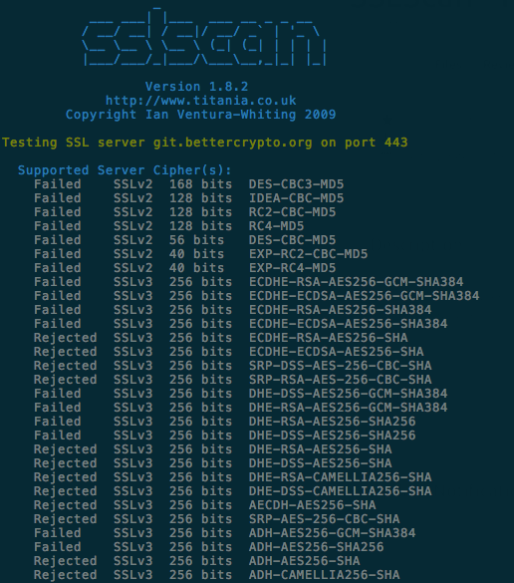
Tools: sslscan

Slide 71
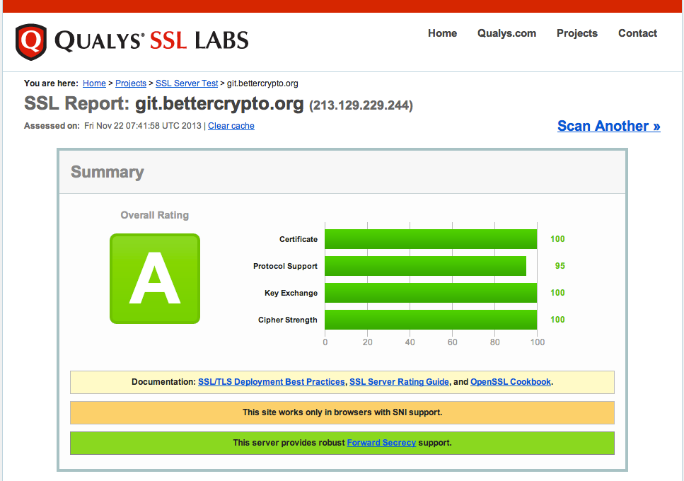
Tools: ssllabs

Slide 72
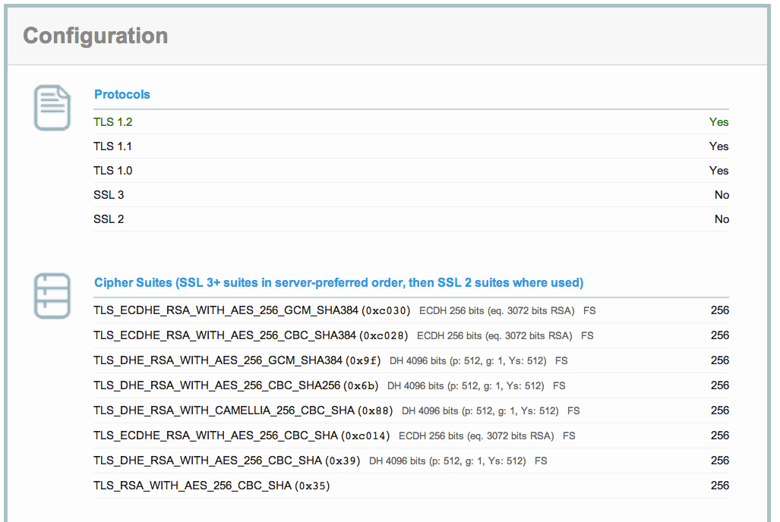
ssllabs (2)

Slide 73
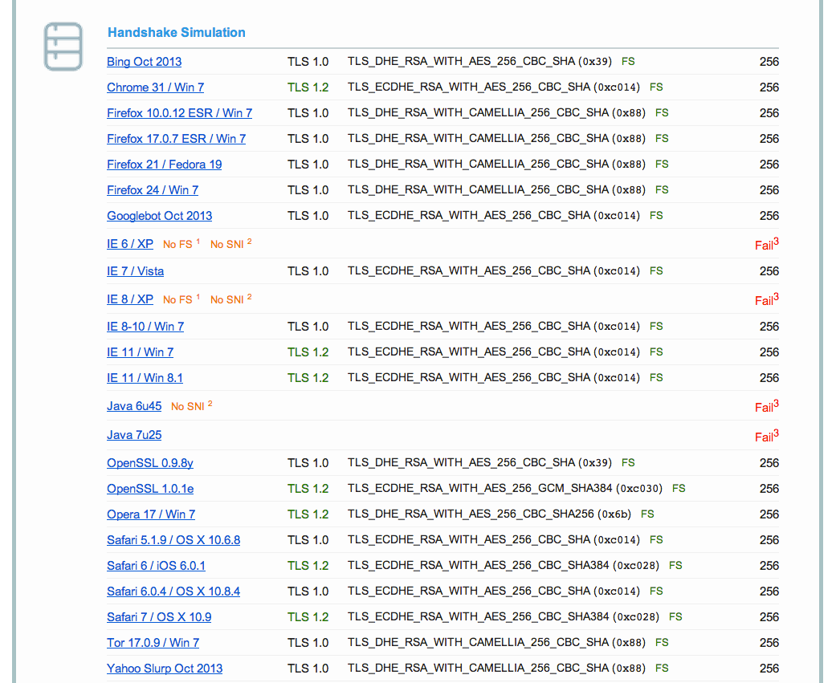
Ssllabs (3)

Slide 74
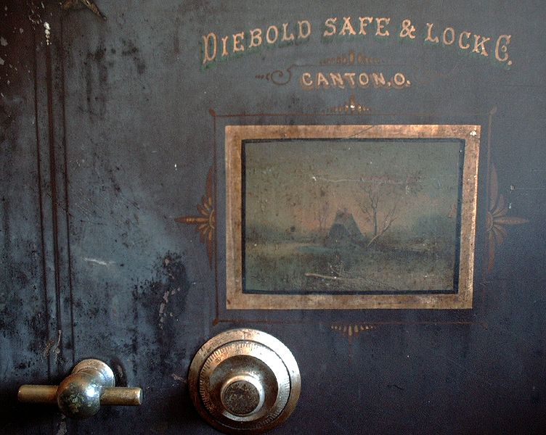
Demo

Slide 75
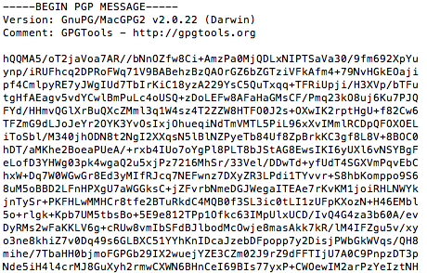
GPG - Encryption
echo "This is a really secret" \ | gpg -a -u <your id>-r <his id> -e

Slide 76
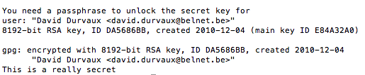
GPG - Decryption
Let’s save the ciphered text to msg.asc
Then uncipher…
gpg -d msg.asc

Slide 77
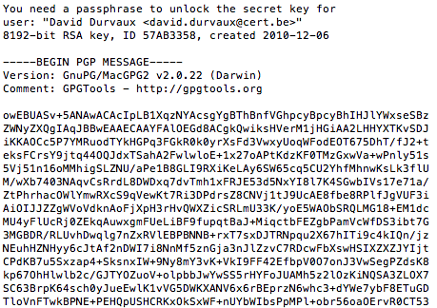
GPG - Signing
echo "This is a really secret" \ | gpg -a -u <your id>-r <his id>-s

Slide 78
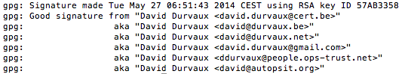
GPG – Check Signature
gpg --verify sig.asc
Differents way to sign / verify:
https://www.gnupg.org/gph/en/manual/x135.html
Other techniques
Clearsigned Documents
Detached Signatures

Slide 79
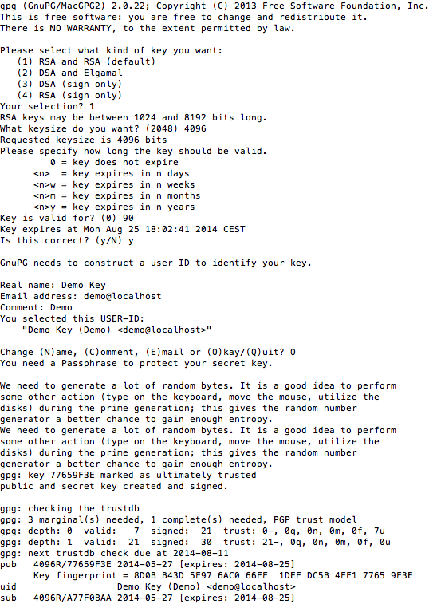
GPG Key generation
gpg --gen-key
Kind of Key
Keylength
Expiration Period

Slide 80
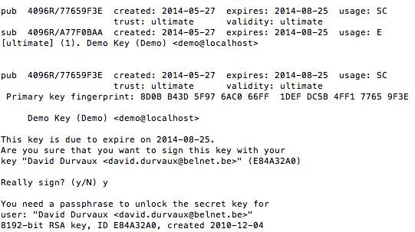
GPG – Key signing
gpg --sign-key -u <your ID> <his id>

Slide 81
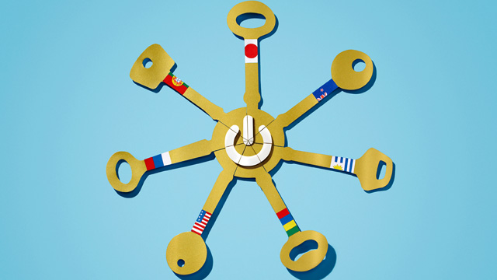
GPG – Let’s do it!
Let’s do a key party!

Slide 82
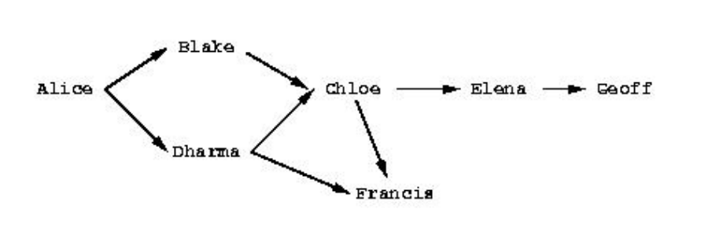
GPG – Sending key
gpg --send-keys <key id>

Slide 83
GPG - Integration
Enigmail (Thunderbird)
GPGMail (Apple Mail)
Symantec PGP
…

Slide 84
Other nice user tools
Ciphered containers:
TrueCrypt ➔ might want to switch now?
Apple’s FileVault2
Password containers
KeePass
LastPass
…

Slide 85
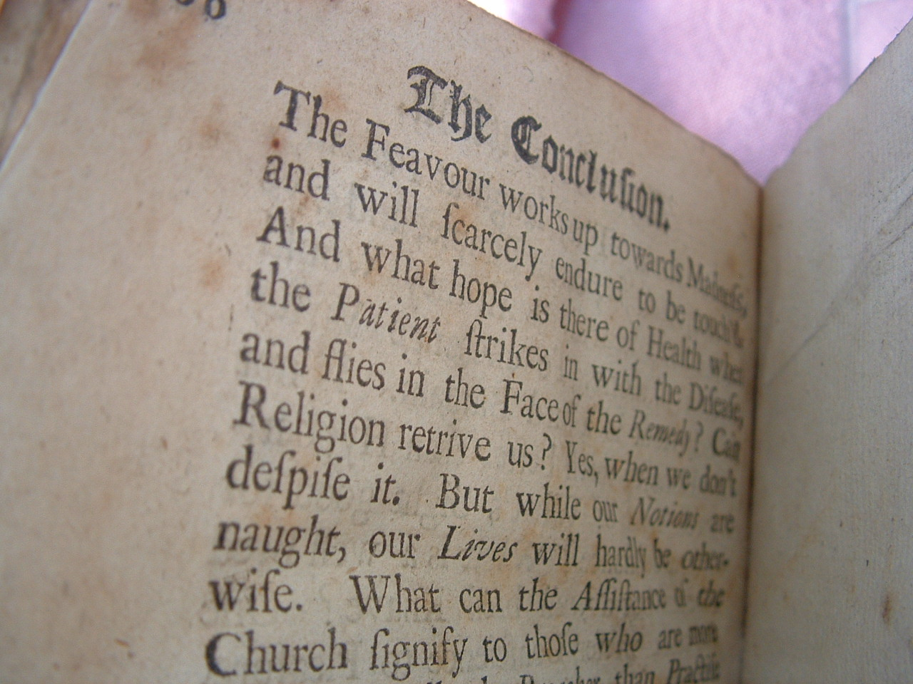
Conclusion

Slide 86
Future ideas
Configuration Generator (online)
Other tools
Other protocols

Slide 87
Current state as of 2014/05/31
Solid basis with Variant (A) and (B)
Public draft was widely presented at the CCC, RIPE meeting, IETF Strint workshop, Linuxdays, ..., M3AAWG
Section „cipher suites“ still a bit messy, needs more work
Need to convert to HTML

Slide 88
How to participate
We need: cryptologists, sysadmins, hackers
Read the document, find bugs
Subscribe to the mailing list
Understand the cipher strings Variant (A) and (B) before proposing some changes
If you add content to a subsection, make a sample config with variant (B)
Git repo is world-readable
We need:
Add content to an subsection from the TODO list → send us diffs
Reviewers!

Slide 89
Thank you!
BetterCrypto.org
https://git.bettercrypto.org/ach-master.git
http://lists.cert.at/cgi-bin/mailman/listinfo/ach
Contact
david@autopsit.org — @ddurvaux

Slide 90
More?

Slide 91
Heartbleed
/* Enter response type, length and copy payload */
*bp++ = TLS1_HB_RESPONSE;
s2n(payload, bp);
memcpy(bp, pl, payload);
payload (pl) and payload_length (payload) are controlled by attacker
memcpy will copy a part of the victim memory to the reply…
Notes:
https://xkcd.com/1354/

Slide 92
ECC
Elliptic curve cryptography (ECC)
Finding the discrete logarithm of a random elliptic curve element
Only knowing a base point
Assumed to be hard
Reduced key length

Slide 93
Some thoughts on ECC
Currently this is under heavy debate
Trust the Math
eg. NIST P-256 (http://safecurves.cr.yp.to/rigid.html)
Coefficients generated by hashing the unexplained seed c49d3608 86e70493 6a6678e1 139d26b7 819f7e90.
Might have to change settings tomorrow
Most Applications only work with NIST-Curves

